Slide 1
International Space App Challenge
Catch a Meteor

Slide 2

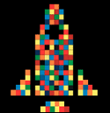
Why this project ?
Help meteors observers around the world
Beginners & experienced
Contribute to science

Slide 3
How ?
Education and guides for new observers
Find the best time to go out there
Assist users to note down their observations

Slide 4
Features
Calendar of meteor showers
Help and tips for better observation
Interactive space view from earth in 3D
Double-tap to add an observed meteor
Store personal observations
Share observations, contribute to science

Slide 5
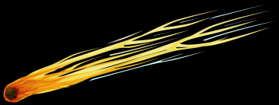
Thanks !

